Slide 1
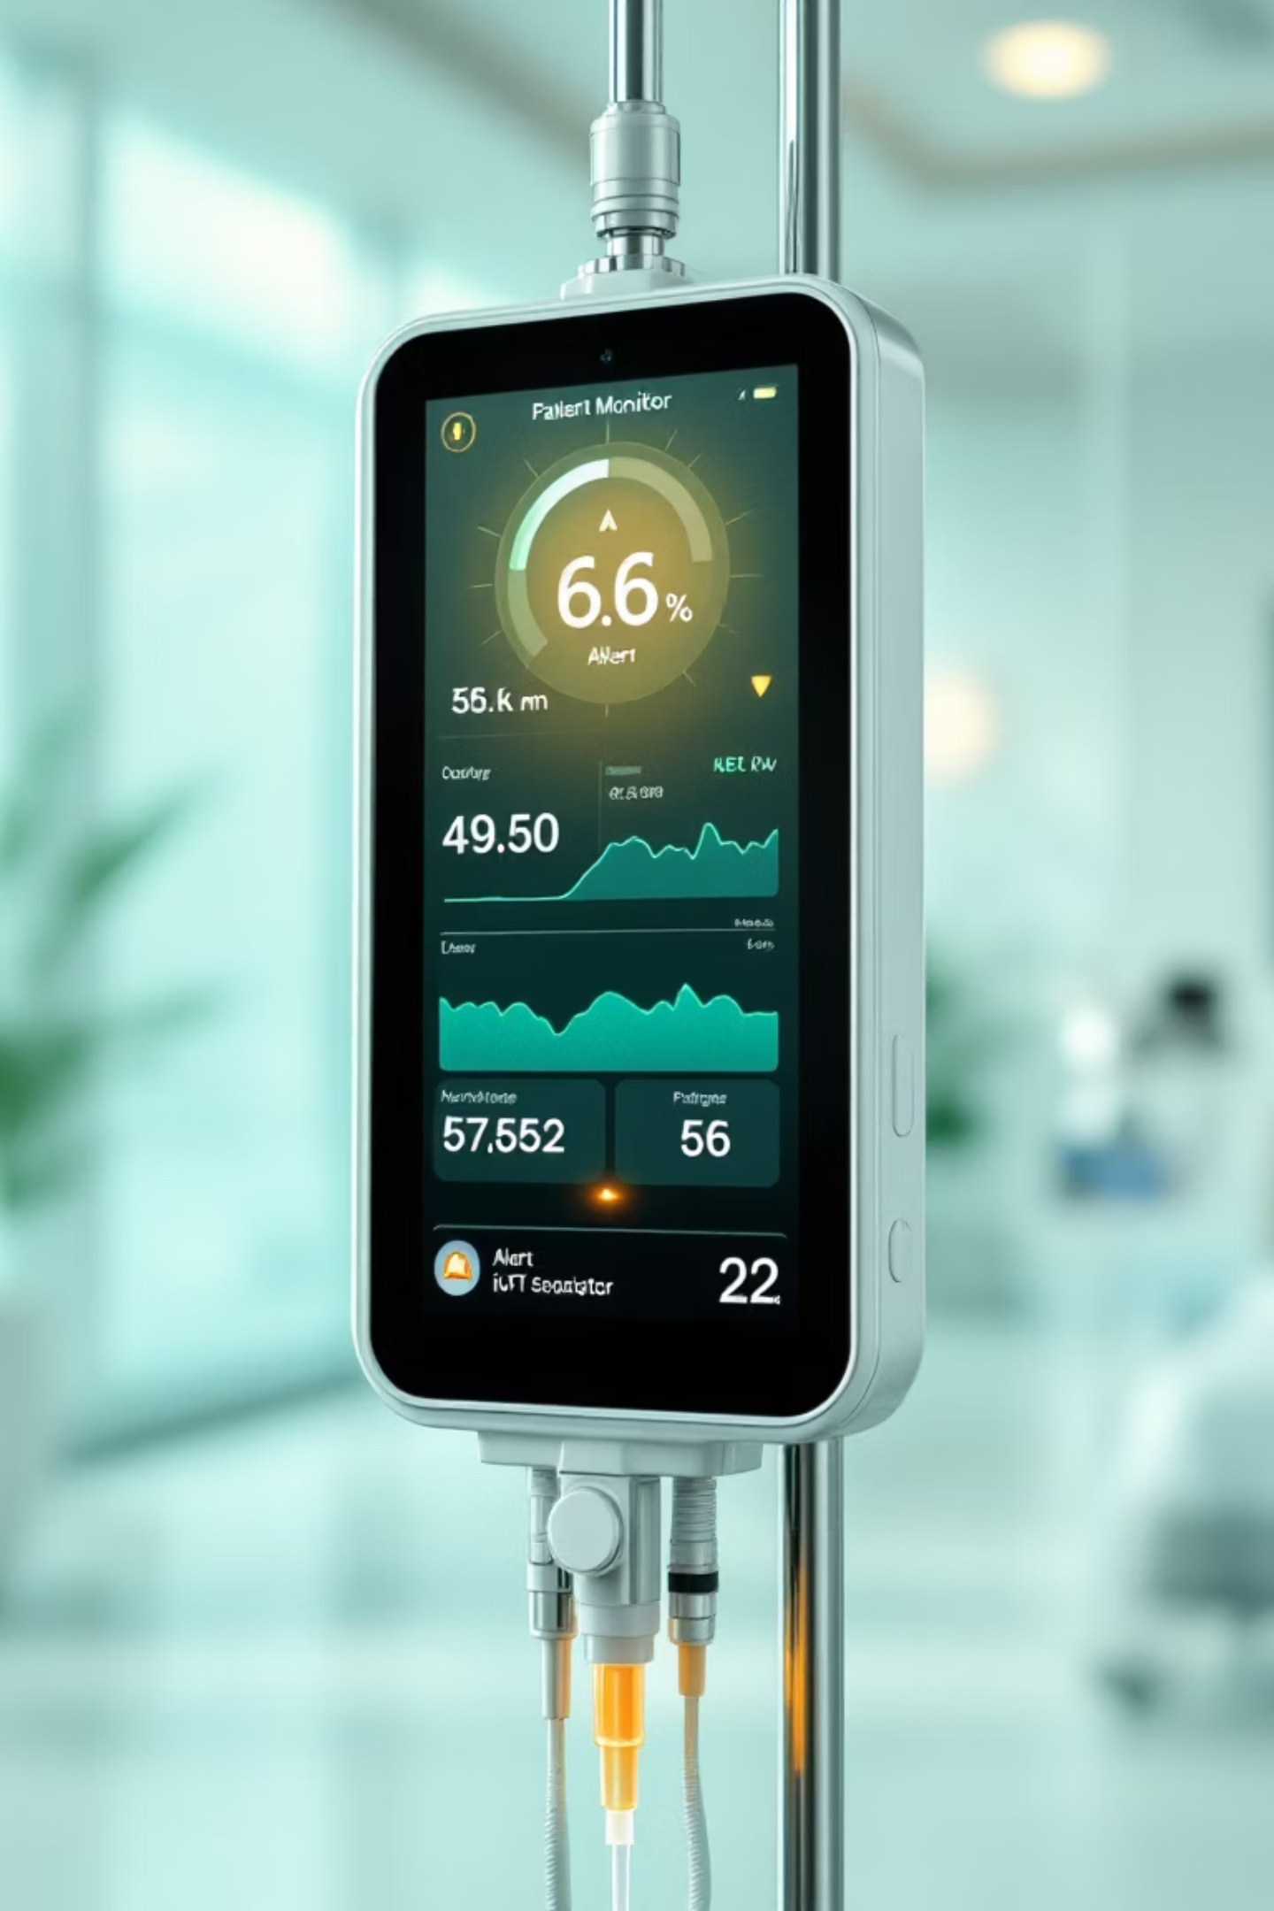
IoT-Enabled Smart IV Drip Monitoring and Alert System
Revolutionizing patient safety through intelligent intravenous fluid monitoring

Slide 2

The Critical Challenge
Manual Monitoring Limitations
Patient Safety Risks
Without continuous monitoring, patients face serious complications that can be prevented with timely intervention.
Traditional IV monitoring relies on nurses manually checking fluid levels every 30-60 minutes, creating gaps in patient oversight.
Air embolism from empty IV lines
Time-consuming manual observation
Treatment delays and interruptions
Human error vulnerability
Delayed response to critical levels
Increased nurse workload stress

Slide 3



Our Smart Solution
ESP32 Microcontroller
Instant Telegram Alerts
Precision Sensors
Advanced processing power with built-in WiFi connectivity for seamless data transmission and real-time monitoring capabilities.
Immediate notifications sent directly to nursing staff devices, ensuring rapid response to critical fluid levels.
Accurate weight or flow sensors provide continuous real-time data on remaining fluid volumes for precise monitoring.

Slide 4
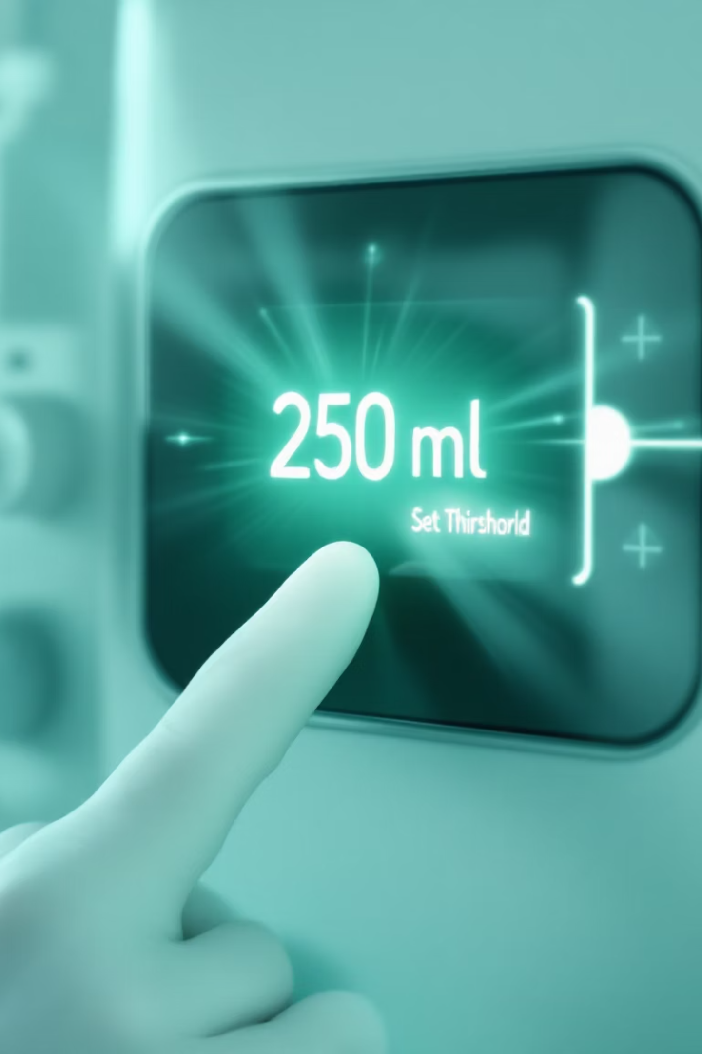
System Configuration
Medical staff can easily customize patient-specific parameters through intuitive push-button controls, setting precise fluid thresholds in milliliters based on individual treatment requirements.
01
02
Set Patient Threshold
Activate Monitoring
Configure IV fluid volume limits using simple push-button interface
System begins continuous real-time tracking of fluid levels
03
Automated Alerts
Proactive notifications trigger when entering critical zones

Slide 5
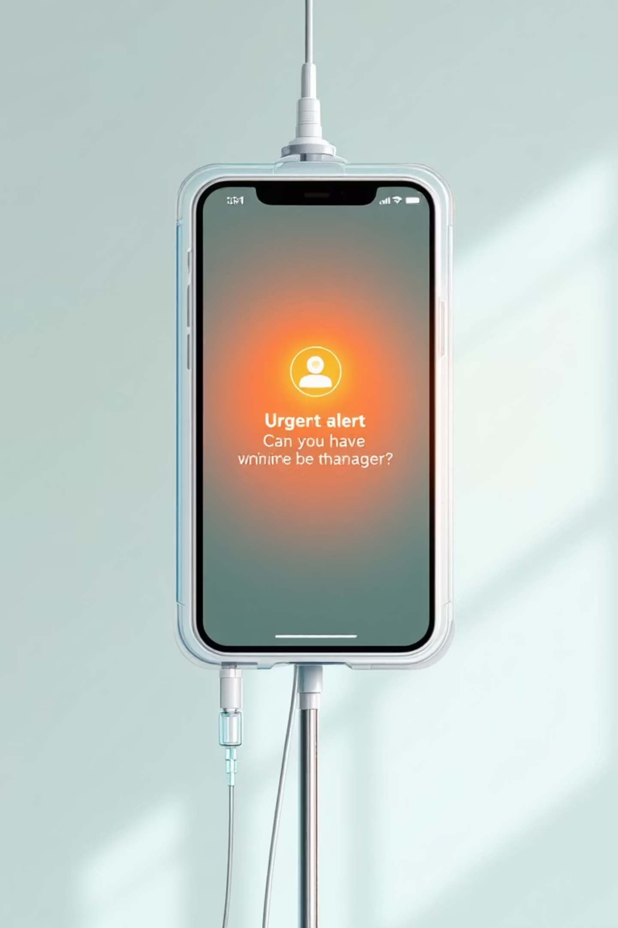
Three-Stage Alert Protocol
1
Initial Alert - 25% Remaining
First Telegram notification sent with patient details and current fluid volume. Allows nursing staff time to prepare replacement.
2
Follow-up Alert - Mid-Range
Second notification maintains awareness as fluid continues to decrease. Reinforces urgency without overwhelming staff.
3
Critical Alert - Final Threshold
Buzzer and LED activate alongside final Telegram message for immediate response. Prevents complete depletion.

Slide 6


Real-Time Monitoring Technology
The ESP32 microcontroller continuously processes sensor data, providing precise fluid level tracking. In the prototype phase, simulated drip flow demonstrates system functionality, while production deployment utilizes advanced weight or flow sensors for clinical-grade accuracy.
Technical Specification: System updates every 30 seconds with measurement accuracy within ±2ml tolerance

Slide 7



Patient Safety Benefits
Proactive Monitoring
Timely Intervention
Reduced Staff Workload
Continuous surveillance eliminates monitoring gaps, ensuring patient safety through automated oversight that never sleeps or becomes distracted.
Three-stage alert system provides graduated warnings, allowing healthcare teams adequate time to respond before critical situations develop.
Automated monitoring reduces manual checking requirements, allowing nurses to focus on direct patient care and other critical responsibilities.

Slide 8
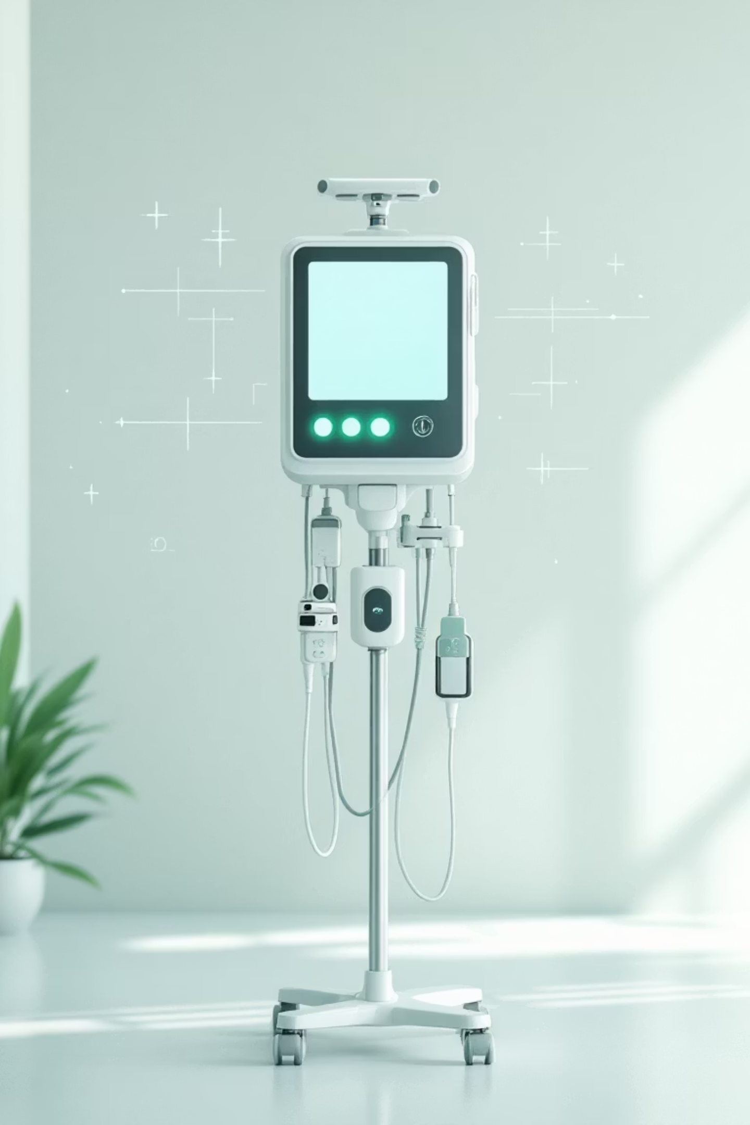
System Advantages
Cost-Effective Design
Scalable Architecture
Low-cost components make widespread hospital deployment financially viable without compromising functionality or reliability.
Modular design allows easy expansion across multiple patient beds and hospital departments with centralized monitoring capabilities.
Adaptable Integration
Compatible with existing hospital networks and electronic health record systems for seamless workflow integration.

Slide 9



Future Healthcare Integration
Hospital Networks
Cloud Analytics
EHR Systems
Integration with existing hospital IT infrastructure for centralized monitoring dashboards
Cloud-based data storage enabling predictive analytics and treatment optimization
Seamless electronic health record integration for comprehensive patient documentation
The system's adaptable architecture positions it as a cornerstone technology for smart healthcare transformation, supporting advanced medical management and improved patient outcomes.

Slide 10
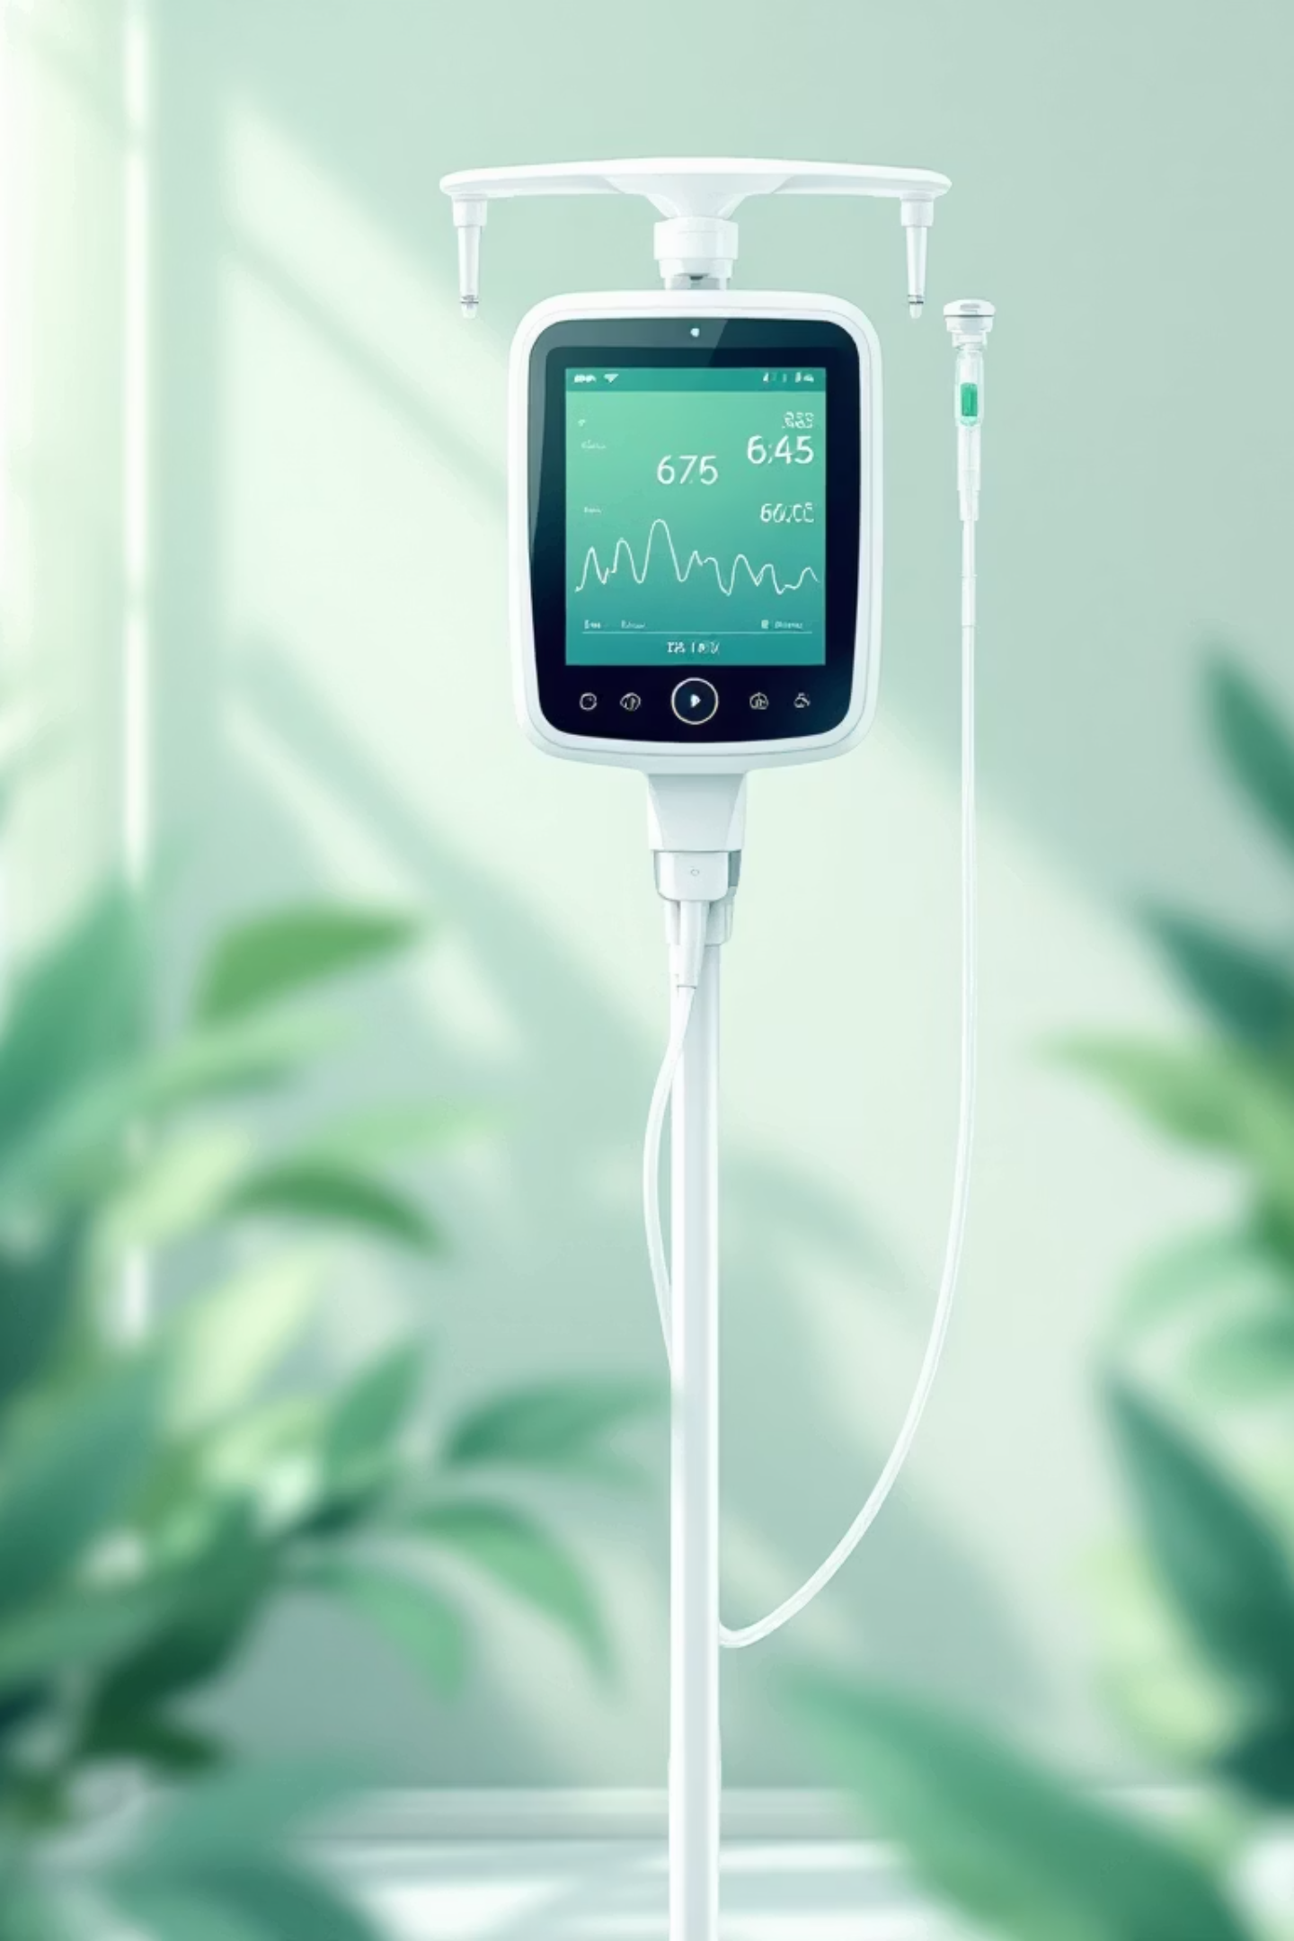
Transforming Patient Care
The IoT-enabled Smart IV Drip Monitoring and Alert System represents a significant advancement in patient safety technology, combining intelligent automation with practical clinical application.
Enhanced Patient Safety
Proactive monitoring prevents complications and ensures continuous care
Improved Efficiency
Reduces manual workload while maintaining high-quality patient oversight
Scalable Solution
Cost-effective technology ready for hospital-wide implementation

